Slide 1
Dots and Boxes
Sabareesh Kkanan
Sina Nejati

Slide 2
Game Rules
Paper and Pencil game for two players.
Empty Grid of Dots.
Players take turn adding a single line.
A player to complete the fourth side of a box ears a point and extra turn.
Game ends when no more lines can be placed.
Winner is the player with the most points.

Slide 3
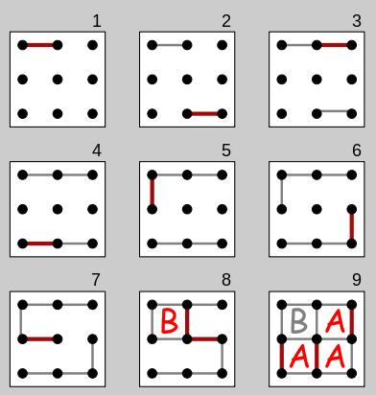
Overview

Slide 4
Why this game?
Dots and Boxes is an Adversarial Game
We were familiar with this game
Seemed to be a challenge

Slide 5
AI for Dots and boxes
How do WE play this game ?
Which AI techniques should we use ?
How to Implement them ?

Slide 6
Search
Search Space:
For 2X2 12! = 479’001’600
For 3X3 24 ! = 6.20448402 × 10²³
For 4X4 40! = 1.24139156 × 10⁴⁷
^{For 5X5} 60!=8.32098711 × 10⁸¹

Slide 7
Implementation
Data Structures
Array of length 60 for lines
Grid – Main grid for the game
Array of length 25
Owner – Stores the owner of the box.

Slide 8
Implementation
Draw()
Evaluates the Radiobuttons
Finds which line to draw
BoxComplete()
Checks if the fourth side of a box is drawn.

Slide 9
A Simple Agent
Avoid adding third side to any boxes!
Add the fourth side if possible!
☺

Slide 10
Implmentation
Agent()
For each line it find condition of adjacent lines
If three are filled it would draw that line
If two are filled it would avoid it.

Slide 11
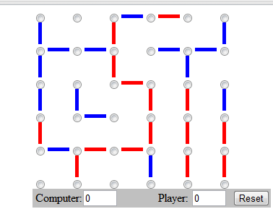
But…
What to do now ? ☹

Slide 12
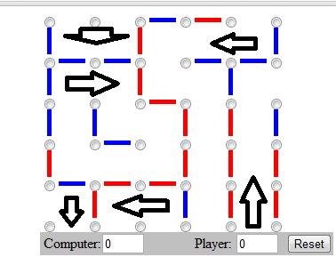
Search
Which move is the best?
Start with the first empty line.
Simulate the Agent
Evaluate the outcome.

Slide 13
A Modified Search
Minimax at the depth of 2
Simulate the agent for MIN
Use the utility function Box(AI)-Box(P)
But one more thing…

Slide 14
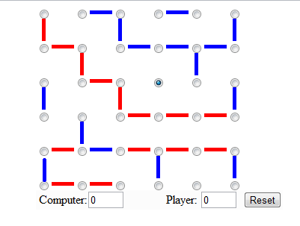
Pruning

Slide 15
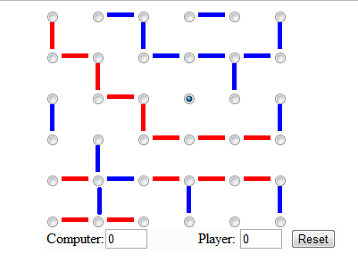
Pruning

Slide 16
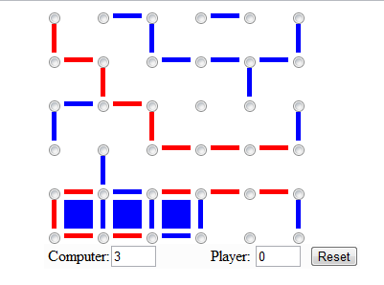
Pruning

Slide 17
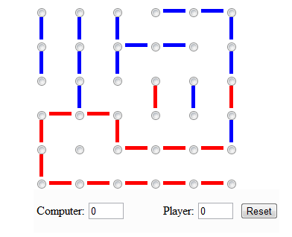
A Challenge

Slide 18
Pruning - Implmentation
Agent is simulated to run in two directions to solve this challenge and groups are stored in space_x and space_y
Now it analyzes this space and chooses the least possible value.

Slide 19
Lessons Learned
Utility function plays a key role.
The system can be tricked if …

Slide 20
Demo time !
Dots and games.

